Slide 1
Social Value & Funding Applications
Conor Mc Gale
Rose Regeneration

Slide 2
Why is Social Value suddenly a “thing”?
Social Value as been part of legislation in England since 2012 (The Public Services Social Value Act 2012), and Scotland since 2013.
The Act requires Public Bodies to think about how they can also secure wider social, economic and environmental benefits in the work they do.
This is normally done via procurement & evaluations of funded projects and schemes that they may administer and is now seen as common practice, with Social Value included in official Government appraisal documentation & guidance.
Its not legislation yet in NI despite several attempts to get it through.
However since June 2022 , public sector tenders must include a minimum of 10% of the total award criteria to score social value. This will apply to contracts for services and works above the threshold where the Procurement Regulations apply (i.e., services contracts valued above £122,976 and consultation contracts valued above £4,733,252). Where appropriate, Departments can also score for Social Value on contracts outside of these thresholds. Departments can also give greater weight to social value than the 10% minimum.
This minimum can increase but is subject to NI Executive approval

Slide 3
What is Social Value?
Social value is the quantification of the relative importance that people place on the changes they experience in their lives…
Examples of social value might be the value we experience from increasing our confidence, from living next to a community park, accessing a community hub, or availing of a service over a prolonged period. These things are important to us but are not commonly expressed or measured in the same way that financial value is.
In short, social value measurement goes beyond financial or economic value and tries to capture social impact in the round.

Slide 4
How Social Value UK defines it?
“Social Value is a broader understanding of value. It moves beyond using money as the main indicator of value, instead putting the emphasis on engaging people to understand the impact of decisions on their lives. The people’s perspective is critical.”
Social value measurement tries to understand and record the relative importance we place on the wellbeing changes we experience. It helps to inform better decision-making to increase positive change, and decrease the negative.

Slide 5
Why is Social Value important?
Knowing what works within your project/org and understanding why – what positive or negative change is happening in people’s lives as a result of work?
Developing a ‘moving picture’ of the distance travelled by your beneficiaries/stakeholders – knowing what outcomes are being achieved over a sustained period of time rather than just counting outputs and meeting targets.
Providing a more rounded view of the work you do – it doesn’t remove having to make difficult decisions but it can help us balance economic, social and environmental trade-offs.
Your beneficiaries see their lives improving as a result of your support.
Staff, volunteers and trustees can see how well you are doing as an organization
Funders/stakeholders can see you are achieving what you said you would and continue to back your organisation.
Ensuring money is directed at projects/programmes that most benefit society and improve people’s lives.
To avoid “impact washing”-by overstating what we are achieving.

Slide 6
Social value is about people’s lives
People experience changes in their lives
Some changes are more important to people than other changes
Social Value is the quantification of the relative importance that people place on the changes
The SROI method uses financial proxies to quantify the relative value of the changes
Notes:
We are all people, and we all interact with a wide variety of other people (stakeholders) everyday, both professionally and personally. What we do affects people’s lives and our lives are affected by the activities and actions of others. Our current accounting system does not take this into account.
Social value looks at the changes that people experience in their lives because of our activities and values these changes. Importantly these changes must be valued from the perspective of those that experience the change. This allows us to capture what is most valuable, and to understand the relative importance of these changes to those that experience them. We can then do more of what is most important, and less of what isn’t.
Bringing social value into view. Giving it visibility.

Slide 7
What are the principles of Social Value
Involve stakeholders
These can be beneficiaries, employees, service users or the wider community. It is important to involve everybody affected by a decision to understand what they value. This enables you to measure impact.
Understand what changes
Articulate how change is created and evaluate this through evidence gathered, recognising positive and negative changes as well as those that are intended and unintended.
Value the things that matter
Recognising the values of your stakeholders & the relative importance of different outcomes that they identify as a result of your work/service/project. This is where financial & non financial values are applied.
Notes:
Principle 1 Involve Stakeholders is a powerful accountability principle that drives through the other principles ensuring that the people who experience the impacts are informing the measurement and management of the impacts on their wellbeing.
Principles 2-5 are primarily accounting principles that inform what information about social value should be collected, and how social value from the stakeholder's point of view should be assessed

Slide 8
What are the principles of Social Value
Only include what is material
Establish the boundaries of what information and evidence you collect. It must give a true and fair picture of your impact, and one that is based on the evidence from stakeholders
Do not over-claim
Only claim the value that the work/project/organiation is responsible for creating.
Be transparent
Demonstrate the basis on which the analysis may be considered accurate and honest, and show that it will be reported to and discussed with stakeholders.
Notes:
Principles 2-5 are primarily accounting principles that inform what information about social value should be collected, and how social value from the stakeholder's point of view should be assessed

Slide 9
What are the principles of Social Value
Verify the result
Ensure verification of your analysis in line with the data you are capturing. Benchmarking may also be included here. In cases where results are being reported to external audiences or are supporting significant decisions, independent assurance may be required.
Be responsive
In other words, what are you going to do with the findings? How is it going to help your work & stakeholders going forward
Social Return on Investment (SROI) is a framework which applies to all of the Eight Principles to account for social value.
Notes:
Principles 6-7 are about disclosing the information and how to build trust in the social value accounts and management practice.
Principle 8 Be Responsive is about how information should be used to inform decisions
that optimise impacts on wellbeing for all materially affected stakeholder groups. It
also ensures that the level of rigour is proportionate for the decisions that the account
is designed to inform.

Slide 10
The Principles and SROI
These principles were first created and published with the publication of The Guide to SROI. https://tinyurl.com/2s39mbrm
Social Return on Investment (SROI) is the framework used for measuring and accounting for an organization or project’s Social Value
Producing an SROI analysis requires the application of all the Principles of Social Value.
Specifically, when applying Principle 3, the valuations of inputs, and impacts are represented in monetary terms in order to generate an SROI ratio.
Notes:
These principles were first created and published with the publication of The Guide to SROI. Producing an SROI analysis requires the application of all the Principles of Social Value. Specifically, when applying Principle 3, the valuations of inputs, and impacts are represented in monetary terms in order to generate an SROI ratio. The Principles were updated in 2014, when Principle 3 “Value what matters” was adjusted to allow for non-monetary valuations, and in 2021, when Principle 8 “Be responsive” was added.

Slide 11
SROI
An SROI analysis can take many different forms.
It can encompass the social value generated by an entire organisation, or focus on just one specific aspect of the organisation’s work.
There are also a number of ways to carry out a SROI analysis. It can done either as an in-house exercise or, alternatively, can be led by an external organisation.
There are two types of SROI:
• Evaluative, which is conducted retrospectively and based on actual outcomes that have already taken place.
• Forecast, which predicts how much social value will be created if the activities meet their intended outcomes
Notes:
These principles were first created and published with the publication of The Guide to SROI. Producing an SROI analysis requires the application of all the Principles of Social Value. Specifically, when applying Principle 3, the valuations of inputs, and impacts are represented in monetary terms in order to generate an SROI ratio. The Principles were updated in 2014, when Principle 3 “Value what matters” was adjusted to allow for non-monetary valuations, and in 2021, when Principle 8 “Be responsive” was added.

Slide 12
The Stages in an SROI Analysis
Carrying out an SROI analysis involves six stages:
1 Establishing its scope and identifying your key stakeholders. It is important to have clear boundaries about what your SROI analysis will cover, the timeperiod of the analysis, who will be involved in the process and how.
2 Mapping outcomes. Through engaging with your stakeholders you will develop an impact map, or Theory of Change, which shows the relationship between your inputs (finance, staff time, volunteers), outputs (your activities) and outcomes (the change you expect to happen as a result of the activities).
3 Evidencing your outcomes and giving them a monetary value. This stage involves finding data to show whether outcomes have happened and then placing a value on them. (Valuations/Proxies)
Notes:
These principles were first created and published with the publication of The Guide to SROI. Producing an SROI analysis requires the application of all the Principles of Social Value. Specifically, when applying Principle 3, the valuations of inputs, and impacts are represented in monetary terms in order to generate an SROI ratio. The Principles were updated in 2014, when Principle 3 “Value what matters” was adjusted to allow for non-monetary valuations, and in 2021, when Principle 8 “Be responsive” was added.

Slide 13
The Stages in an SROI Analysis
4 Establishing impact. Having collected evidence on outcomes and monetised them, you need to consider those aspects of change that would or could have happened anyway without your intervention. These other factors are calculated and included as part of the analysis. (Deflators)
5 Calculating the SROI. This stage involves adding up all the benefits that you have calculated, subtracting any negatives (deflators) and comparing the result to the investment made into the service (finances, staff & volunteer time etc).
6 Reporting, using and embedding the results. Easily forgotten, this vital last step involves sharing findings with stakeholders and responding to them, embedding good outcomes processes and verification of the report.
Notes:
These principles were first created and published with the publication of The Guide to SROI. Producing an SROI analysis requires the application of all the Principles of Social Value. Specifically, when applying Principle 3, the valuations of inputs, and impacts are represented in monetary terms in order to generate an SROI ratio. The Principles were updated in 2014, when Principle 3 “Value what matters” was adjusted to allow for non-monetary valuations, and in 2021, when Principle 8 “Be responsive” was added.

Slide 14
How SROI can help you
It can help your organisation by:
• raising your profile;
• improving your case for further funding;
• making your tenders/funding cases more persuasive
demonstrating your effectiveness to your stakeholders
Identify potentially new projects/areas of work
It is less useful when:
• a strategic planning process has already been undertaken and is already being implemented;
• stakeholders are not interested in the results;
• it is being undertaken only to prove the value of a service and there is no opportunity for changing the way things are done as a result of the analysis
Notes:
These principles were first created and published with the publication of The Guide to SROI. Producing an SROI analysis requires the application of all the Principles of Social Value. Specifically, when applying Principle 3, the valuations of inputs, and impacts are represented in monetary terms in order to generate an SROI ratio. The Principles were updated in 2014, when Principle 3 “Value what matters” was adjusted to allow for non-monetary valuations, and in 2021, when Principle 8 “Be responsive” was added.

Slide 15
Theory of Change

Slide 16
Where to Start?
Theory of change: this is a diagram setting out change and what, why, when and how a project or initiative is contributing to that change. It shows the links between inputs, interventions, outcomes and longer-term goals that all lead to change.
Confirm what you want to measure and over what time period: what are the aims and objectives of the activity, why is it needed, what support have you provided, and what are the longer term effects of the intervention [theory of change]?
Monitoring and evaluation framework: clarifying what pieces of information you need to collect to evidence your theory of change.
Data audit: mapping out where your data is: what information you collect (who, where, when, how, why) about your project and in your organisation more broadly. This is an opportunity to review the consistency of the data you are collecting: its format, scope, and to see if there any gaps and how will you fill these.
Describe your outputs, set indicators, and describe your outcomes and how you will measure them.
Notes:
These 1st 2 points are interlinked

Slide 17
Where to start?
Beneficiary journey mapping: for an individual(s), visualising how their needs are assessed, the services and support they are offered, typical pathways through your organisation and others you work with. This needs to measure the ‘added value’ that you offer at each step (e.g. quality and experience of staff, partnership working, cost to deliver).
Understand what it costs to deliver the activity – this could include a grant, volunteer time, venue hire [everything you need to deliver the activity even if you don’t directly pay for it].
Other factors have contributed to the outcomes your beneficiaries have achieved – think through how you will account for these factors: leakage, deadweight, attribution, drop off and displacement (e.g. a survey or focus group with beneficiaries and/or external stakeholders).
Notes:
Just to come back to some key principles. Before you begin to help you in this process we will provide you with a simple planning sheet to help map out your project and identify the closest financial proxies that match your activities.
You need to confirm what you want to measure and over what time period. Thinking about what data and information you already collect is really important .That’s really helpful when using the engine but it’s also really helpful when thinking about things like unit costs, you’d be surprised how many people don’t know how much it cost’s to deliver their particular project.
And this point at the bottom, understanding other factors that have contributed to the outcomes is key to ensuring you don’t overclaim and indeed only claim the value your activities are responsible for. This ensures a credible Social Value Impact report, one that you can really stand behind, and we’ll come on and talk about what we call deflators how you actually need to think when you’re doing social value about leakage, deadweight, attribution, drop off and displacement to make sure that you’re truly recording the value of the impact not just inadvertently bigging it up.

Slide 18
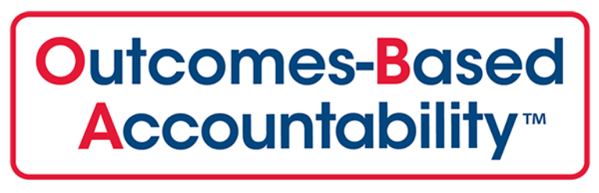
So many methods and tools!

Slide 20
What is the Social Value Engine?
Developed over a 10-year period by Rose Regeneration. An online tool accredited by Social Value UK that systemises the process of measuring social value– it helps charities, VCS bodies, community groups and public sector organisations to forecast, plan and evaluate their activities.
It contains 370+ peer-reviewed financial proxies, derived from reliable sources and is regularly updated.
There is scope to customise and/or add new financial proxies.
It provides a description of how a project creates value and a ratio (£x of social value is created for every £1.00 invested).
It has a Programme Function to amalgamate projects for an overall social value return.
It is ‘Place based’: showing how activities are making a place better to live in and the community more sustainable.
Notes:
Just to give you a little bit of history - The social value engine was developed over a 10 year period by economic and regeneration academics here at the East Riding and our partners Rose Regeneration, in response to the Public Services (Social Value Act 2012).
The SVE is a web based software tool that systemises the process of measuring social value. It provides a monetary value to your outcomes meaning not only can you measure your value simply and consistently, it demonstrates the full range of impacts your project has achieved rather than just outputs alone.
It does this by giving you access to over 360 peer-reviewed financial proxies. A financial proxy is a sourced approximation of value where an exact measure is impossible to obtain. The proxies are derived from reliable sources, all publicly available and a link to each report is shown on your calculation. The proxies are reviewed and updated annually by a team of academic researchers and you can also add your own proxies or request for new ones to be sourced. Included in the 360 are also almost 100 Northern Ireland Specific Values as we work closely with our partners in NI and appreciate that there are geographical differences.
Over 50 organisations using the engine with 150 individual licence holders showing our clients have confidence and find value in the sve as they are renewing their contracts with us yearly.
The SVE is a cost effective self serve software and licences start from just £1,250 per year. A full breakdown of the packages will be sent to you after the session, these include individual, small and large group packages plus further cost effective plans if purchased for multiple years .
All costings include initial set up and personal training to suit your needs – this incudes helping you identify the relevant activities and suitable proxies within the Engine Plus we invite you and your colleagues to regular monthly user group sessions, where we can share best practice, observe how others are using the Engine and we do a quick refresher at each session.
The other thing that’s key is the real focus on community and being place based and localised to your communities needs, so in addition to generating a ratio that tells you how much sv has been created per £ invested, it also gives you two frameworks to chose from against which you can break down the impact you’ve had ,either the Bristol Accord or Sustainable development goals.

Slide 21
Notes:
The Sustainable Development Goals are more commonly used as they are a more contemporary means of assessing sustainability, they have a global context and are “owned” by the UN having been adopted in 2015. Each of the outcome categories and financial proxies in the SVE are tagged against both Frameworks so you can choose which to align against and when you come to the final report it gives you an impact breakdown of which domains or areas of the 17 sdg or 8 Bristol accord you are achieving, so not only will it give you a social return on investment, it will also report on how your activities are making a place more sustainable.
We will show you this in more detail when we show you the final report. We also have a number of organisations who have made the engine bespoke to their organisations needs by having their priorities added as an additional framework, therefore can report on their impact against their org’s aspirations.

Slide 22
Functions available in the Social Value Engine
Forecast – when creating Feasibility studies and to show the potential SROI of a project/funding application
Evaluation – when looking at Actual results
Agile – When you need a quick and Simplified SROI
Extensive – Full SVUK & International Accredited version
Programme function – combine individual project reports in to one over arching report
Your organisation – used when Managing user activity and seeing what others in your organisation are doing
Visual reports – both PDF and Microsoft Excel versions
Notes:
The SVE has many functionalities and is constantly evolving to meet your needs:
Forecast – when creating Feasibility studies and to show the potential SROI
Evaluation – when looking at Actual results
Agile – When you need a quick and Simplified SROI
Extensive – Full SVUK & International Accredited version
Programme function – combine individual project reports in to one over arching report
Your organisation – used when Managing user activity and seeing what others in your organisation are doing
Comparison – Contract Management - shows actual versus forecast
Visual reports – both PDF and Microsoft Excel versions
Impact card design – ideal for marketing purposes

Slide 23
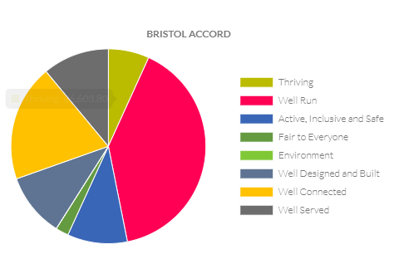
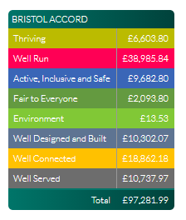
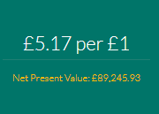
Your own social value project report
Notes:
We work with organisations
Confirm what you want to measure and over what time period: what are the aims and objectives of the activity, why is it needed, what support have you provided, and what are the longer term effects of the intervention [theory of change]?
Review what data and information you collect about the activity you want to measure: how is it collected, by whom, when, and for all beneficiaries or a sample?
Understand what it costs to deliver the activity – this could include a grant, volunteer time, venue hire [everything you need to deliver the activity even if you don’t directly pay for it].
Other factors have contributed to the outcomes your beneficiaries have achieved – think through how you will account for these factors: leakage, deadweight, attribution, drop off and displacement (e.g. a survey or focus group with beneficiaries and/or external stakeholders).

Slide 24
Example of potential COF Project

Slide 25
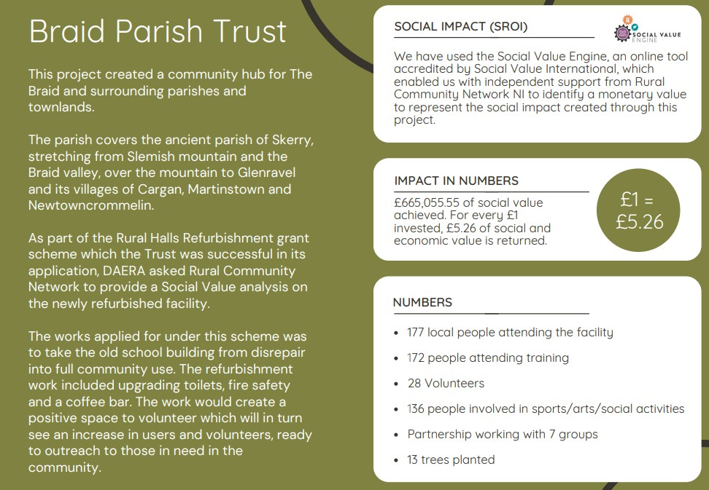

Slide 31
Community Finance Ireland
Notes:
Marketing-
Impact Reports!
Social Media particularly Facebook (for groups), Twitter & Linked in (Statutory Bodies, Funders etc)
Website particularly for the Impact Reports
Networking Opportunities/Conferences
Meetings
One off Showcase Events (Oxford Island)
Word of Mouth or “Ambassadors” for the work you do

Slide 32
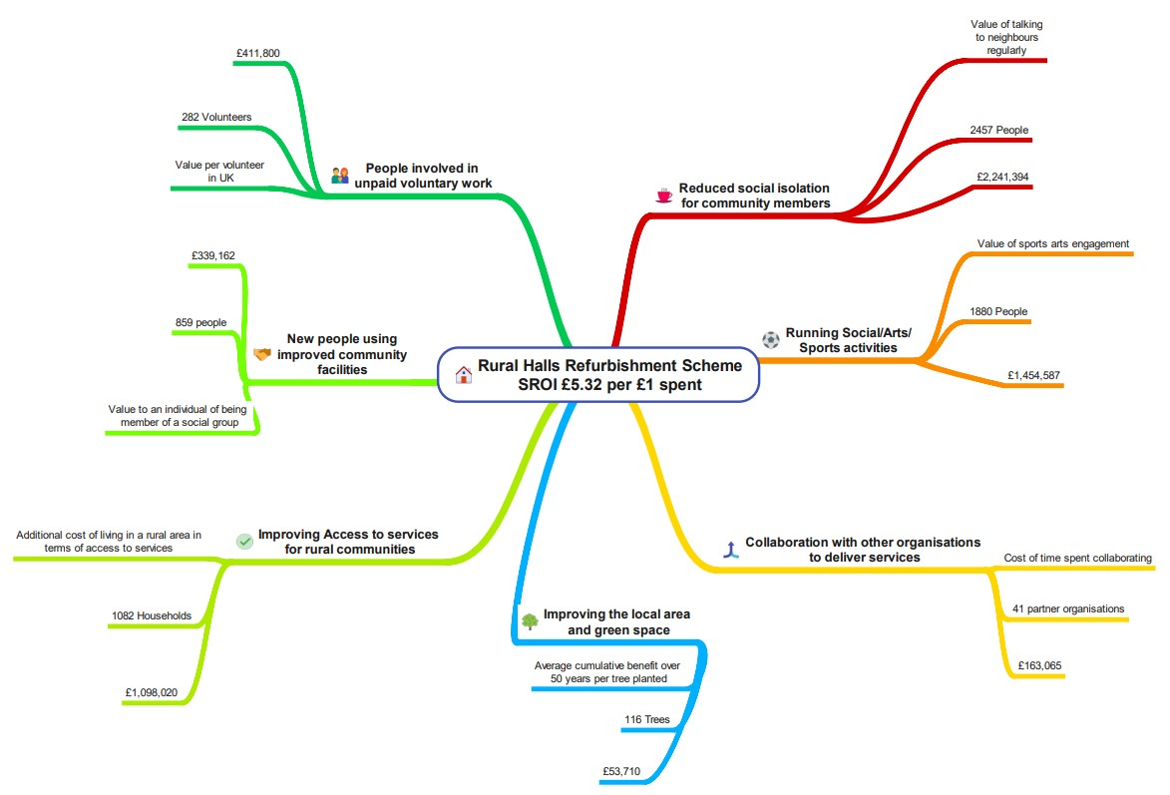

Slide 33
What SVE offers
Organisations can purchase the licence for 1 year period. Online training and support is provided throughout the 12 months along with access to our regular fortnightly online support sessions.
If further support is needed, we can offer this at an additional daily rate and it covers:-
Assisting your organisation with its Theory of Change
Reviewing the data your project collects helping identify gaps
Working with organisation in improving how they measure the impact their services/project may have with stakeholders i.e. surveys, focus groups, case study examples
Assisting organisations in calculating the deflator figures and applying them
Work with you in identifying the input costs of the project: i.e. grants, donations, volunteer time, in –kind expertise etc.
Provide a overall project report illustrating this, and recommended next steps in continuing the Social Value process within their organisations
Design an Impact Report that groups can share online or as part of their individual marketing activities
Notes:
Leakage: How much of an outcome might have delivered an impact outside of the area that the group intended;
Deadweight: How much of the outcome might have been achieved without intervention;
Attribution: What proportion of an outcome might be attributed to others because their activity contributed to it;
Drop-Off: What proportion of the outcome will diminish over time;
Displacement: How much of the outcome has displaced other similar projects;

Slide 34
Contact Details
Conor Mc Gale
Tel: 07745 665290
conor.mcgale@roseregeneration.co.uk
https://socialvalueengine.com/
https://www.linkedin.com/company/social-value-engine/

